Slide 1
Fatigue Curves
Python Application
9 June 2018

Slide 2
Agenda
Introduction
Theory
Fundamentals
Basic curve
Standard references
Miscellaneous data
software

Slide 3
Introduction
Python application to help O&G industry to understand fatigue curves
Understanding the theory behind Fatigue curves and modelling tools(shear7)
Compiling data and placing data in database.
Data location: “Dropbox\0119 Programming\017 Fatigue Curves\Ref\SN Curve Definitions.xlsx"

Slide 4
Data Flow

Slide 5
Flowchart
FYI

Slide 6
Coding

Slide 7
Coding
TBA

Slide 8
Python Libraries
Modules needed for compiling data and for plotting
Module | software | Description
Xlrd | Python | Reading the data using excel file
Pandas | Python | Manipulating excel
Matplotlib | Python | For plotting curves
Xlwt | Python | Writing the data to excel file

Slide 9
THANK YOU
For the opportunity to serve

Slide 10
Theory and Fundamentals

Slide 11
Theory
THEORY
Theory behind fatigue curves
Equation:
S – stress range in Mpa
a – value corresponded to S in stress range.
Modelling tools
Shear7 for vortex-induced vibration analysis

Slide 12
Fundamentals
Major things to understand before starting project
Fatigue: the weakening of a material caused by repeatedly applied loads. It is the progressive and localized structural damage that occurs when a material is subjected to cyclic loading. it consists of cyclic and variable loadings.
Fatigue limit: this is that load limit below which material gains infinite life
Endurance: The maximum value of completely reversed bending stress that a material can withstand without any failure.
Endurance limit: The maximum value of completely reversed bending stress that a material can withstand without any failure for ‘infinite number of cycles’.
The very basic difference between fatigue and endurance limit is that the endurance limit has cycle number mentioned with i
Note: S-N curve a plot of the magnitude of an alternating stress versus the number of cycles to failure for a given material

Slide 13
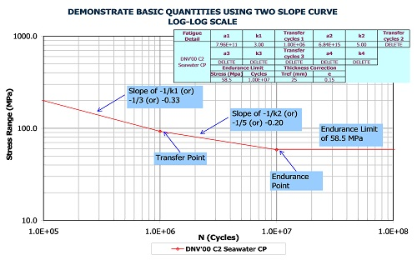
Basic curve
Explanation of points and limits explanation through graphical representation

Slide 14
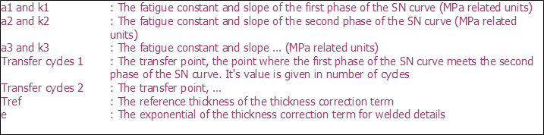
Notes for graph
Slopes point Explanation

Slide 15
Standard reference
References for different curves for fatigue analysis
[1] | American Petroleum Institute - "Recommended Practise for Planning, Designing and Constructing Fixed Offshore Platforms – Load and Resistance Factor Design". API-RP-2A-LRFD, Second Edition, Apr 1994.
[2] | Det Norske Veritas (DnV) - "Fatigue Strength Analysis for Mobile Offshore Units", Aug 1984.
[3] | Norsok Standard - "Design of Steel Structures". N-004, Rev 1, Dec 1998.
[4] | Det Norske Veritas (DnV) - "Fatigue Design of Offshore Steel Structures" (DnV-RP-C203), Aug 2005.
[5] | Det Norske Veritas (DnV) - "Fatigue Design of Offshore Steel Structures" (DnV-RP-C203), Aug 2000.
[6] | Values for titanium supplied for Agbami (job 1378) - originally from OTC 8409 "Advances in Titanium Risers for FPSO's"; Carl Baxter et al 1997.
[7] | Value used on Asgard project (1570) - Based on data from Marintek 1998.
[8] | Values for titianium supplied for Kristin (job 1599) - based on data from Marintek; From OMAE papers "Fatigue strength of titanium riser welds effects of material grade and weld method", OMAE 2002/MAT-28576 & "Fatigue of 28-inch titanium riser – sn data and defect assessment", OMAE 2002/MAT-28577.
[9] | Det Norske Veritas (DnV) - "Fatigue Design of Offshore Steel Structures" (DnV-RP-C203), Apr 2008.
[10] | BP Engineering Technical Practises, "Riser Fatigue Calculation Guidance Note", GN65-704, Revision 2, Jun 2008.
[11] | Det Norske Veritas (DnV) - "Fatigue Design of Offshore Steel Structures" (DnV-RP-C203), Apr 2010.
[12] | Det Norske Veritas (DnV) - "Fatigue Design of Offshore Steel Structures" (DnV-RP-C203), Oct 2011.

Slide 16
Miscellaneous data
tref = reference thickness equal 25 mm for welded connections other than tubular joints. For tubular joints the reference thickness is 32 mm. For bolts tref = 25 mm
Different slopes selection based on project requirement
Single slope (0 Stress Cut off)
Note: Please note that highest stress range curve from multi-slope data is used for single-slope
Single slope (with Endurance limit/ stress cut-off)
Multi-slope (0 Stress Cut off)
Multi-slope (with Endurance limit/ stress cut-off)
Note: Please note that endurance limit is probably only used for research purposes and typically NOT for project work

